Slide 1
Images and Tables
CTEC 130

Slide 2
Images

Slide 3
<img> Review
<img src=”images/dinosaur.jpg” alt=”A Dinosaur Picture”>
<img> tags should always include an alt tag
If the image is decorative, alt can be “”, though you should also look into replacing it with a CSS background-image
You can use width and height attributes to tell the browser the size of the image before it loads
This helps prevent the page from “popping” out and shifting content while images load
Images should be resized before being used on your site

Slide 4
<figure> and <figcaption>
Semantic tags which can be used to organize text and image content that goes together
<figure>
Contains your <img> tag and a <figcaption> for the text that describes it
Can contain something other than an image as well (like a video, audio, graph, etc.)
<figcaption>
Contains text that provides extra context on your image
Your figcaption should add extra context to your image, not just repeat what the alt text says
The alt text describes the image to those who can’t see it, the figcaption adds context for all

Slide 5
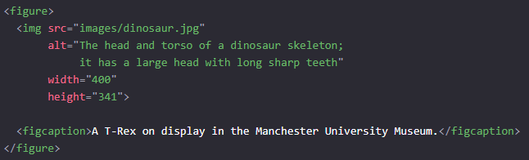

Slide 6
Advantages of Figure
Adds semantic context to your site
Provides specific tags to target with CSS

Slide 7
CSS Image Tricks

Slide 8
Image Swapping Problems
Browsers have to find and download each individual image referenced in your HTML and CSS documents
The HTML loads first, then loads any resources it references
You can swap-out images on :hover, but the browser won’t load the replacement image until it needs it
Duplicate images also take up extra storage space
Video Games solved this with Sprite Sheets, so we can do something similar

Slide 9

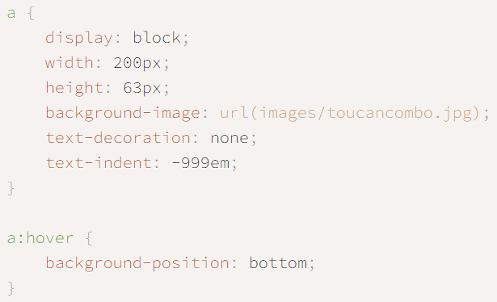
CSS Rollover
The Trick:
Create a single image file that contains all versions of your image
Set this image as a css background image on your interactable element, using positioning to hide the other versions
When you hover on the link, don’t change the image, change the position

Slide 10
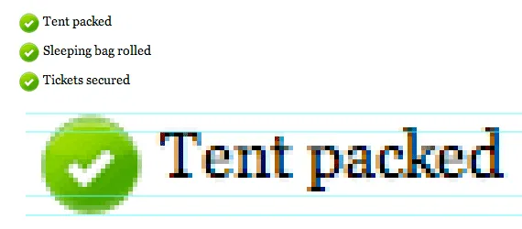
Centering Images to Text
This only works if images are displayed as inline and if you’re using <img> tags
You can use the css rule vertical-align: middle; to align an image to the middle of a text-line
This can be helpful with images set alongside lists

Slide 11
HTML Tables

Slide 12
When to Use Tables
Use Tables For:
Displaying data
Representing something where data is stored in columns or rows
If it’s something you might use a Spreadsheet for, then a Table may be appropriate
NEVER Use Tables For:
Positioning Elements on a Page
Centering an item
Creating spacing
Why?
Table layout is inaccessible
Tables produce “tag soup”
Tables are not responsive

Slide 13
Table Tags
<table></table>
Defines the start and end of your table
<tr></tr>
Defines the start and end of a table row
<td></td>
“Table Data,” represents a single cell in a table
<th></th>
“Table Header,” represents a cell that contains some kind of heading (like a column or row label)

Slide 14
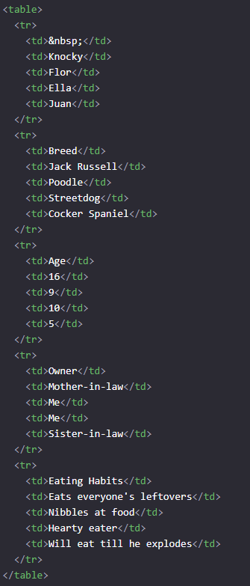
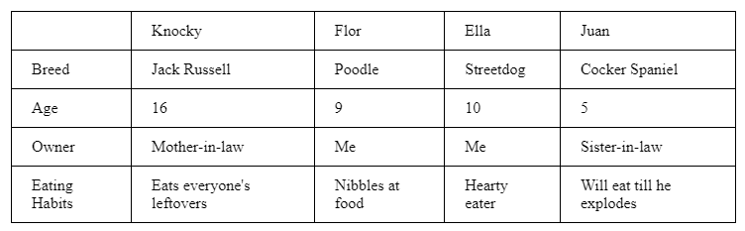

Slide 15
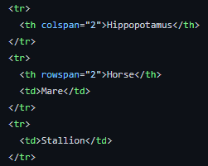
Spanning Columns and Rows
You don’t pre-define how many rows and columns your table has
HTML just tries to figure it out by your <tr>, <td> and <th> tags
The colspan and rowspan attributes can be used to span a cell across multiple rows/columns

Slide 16
Managing Columns
You don’t have to provide information on columns, as HTML just figures out how many columns are necessary to build the table you want
However, if you want to consistently style your cells based on their column, you can define columns via <col> and <colgroup>
<colgroup></colgroup>
Defined inside of <table> just before any <tr>s are defined
Contains <col> tags that define how many columns the table has
<col>
Doesn’t have a closing tag
Defined inside of <colgroup>
You can provide classes/ids to style the cells that this column represents

Slide 17
Accessibility and Tables

Slide 18
Table Structure Notes
<th> tags should be used for any “labels” in your table
These help the labels visually stand out in your table
When paired with a “scope” attribute, they help accessibility software understand and better read out your table
<thead>, <tfoot> and <tbody> provide a styling hook for the parts of your table
<thead> should surround the <tr>s that make up the “head” of the table (the part with all the labels)
<tfoot> should make up the “foot” of the table, usually a part that includes sums or summary information
<tbody> should contain the cells that make up the rest of your table
These are not required, and you can leave them out if they don’t make sense for your table
For example, a table with no summary information doesn’t need a <tfoot>
These don’t provide any accessibility features, just CSS styling features

Slide 19
<caption>
Describes the contents of the table
Should be defined inside of <table></table> right at the start
Screen Readers can provide context of a table via the caption, giving users the ability to skip reading it all out if it doesn’t seem interesting

Slide 20
The scope Attribute
Can be added to <th> tags to provide information of what they’re the heading of
scope=”col” - this th is a heading for a column
scope=”row” - this th is a heading for a row

Slide 21
Styling Tables

Slide 22
Table CSS Properties to Know
border-collapse
Prevents duplicate borders on cells by forcing adjacent borders to “collapse” together
border-spacing
The spacing set between cells in a table, set as a measurement unit
text-align
Can be used to left align, center or right-align table cell contents
vertical-align
Can be used to vertically align content inside of cells
Otherwise most other CSS properties can also be used with Tables

Slide 23
:nth-Child() tricks
:nth-child() is a pseudo-class that allows you to select a child of an element in CSS based on its relative position amongst siblings
li:nth-child(2) - selects the second <li> element in a list
We can use :nth-child() with some special arguments to target alternative rows in a table
tr:nth-child(odd) - targets all the odd rows
tr:nth-child(even) - targets all the even rows
This allows us to create a “stripe” effect that makes tables easier to read

